Slide 1

CDA 3101 Spring 2016
Introduction to Computer Organization
MIPS Pipelining
08 March 2016
Notes:
We will study how the algorithms for the basic operations on the number representation we are using (2’s complement) are implemented using the lower level support (digital design elements: gates). ALU central to all MIPS instructions.

Slide 2
Pipelining
Overlapped execution of instructions
Instruction level parallelism (concurrency)
Example pipeline: assembly line (“T” Ford)
Response time for any instruction is the same
Instruction throughput increases ☺
Speedup = k x number of steps (stages)
  Theory: k is a large constant
  Reality: Pipelining introduces overhead

Slide 3
Pipelining Example
Assume: One instruction format (easy)
Assume: Each instruction has 3 steps S1..S3
Assume: Pipeline has 3 segments (one/step)
Input
Cycle 1 Cycle 2 Cycle 3 Cycle 4 Cycle 5
S1 S2 S3 S1 S2
S1 S2 S3 S1
S1 S2 S3
Time
New Instruction
Seg #1
Seg #2
Seg #3

Slide 4
MIPS Pipeline
MIPS subset
  Memory access: lw and sw
  Arithmetic and logic: and, sub, and, or, slt
  Branch: beq
Steps (pipeline segments)
  IF: fetch instruction from memory
  ID: decode instruction and read registers
  EX: execute the operation or calculate address
  MEM: access an operand in data memory
  WB: write the result into a register

Slide 5
Designing ISA for Pipelining
Instructions are assumed to be same length
  Easy IF and ID
  Similar to multicycle datapath
Few but consistent instruction formats
  Register IDs in the same place (rd, rs, rt)
  Decoding and register reading at the same time
Memory operand only in lw and sw
Operands are aligned in memory

Slide 6
Hazards (1/2)
Structural
  Different instructions trying to use the same functional unit (e.g. memory, register file)
  Solution: duplicate hardware
Control (branches)
  Target address known only at the end of 3rd cycle => STALLS
  Solutions
    Prediction (static and dynamic): Loops
    Delayed branches

Slide 7
Hazards (2/2)
Data hazards
  Dependency: Instruction depends on the result of a previous instruction still in the pipeline
    Add $s0, $t0, $t1
    Sub $t2, $s0, $t3
  Stall: add three bubbles (no-ops) to the pipeline
  Solution: forwarding (send data to later stage)
    MEM => EX
    EX => EX
  Code reordering to avoid stalls

Slide 8
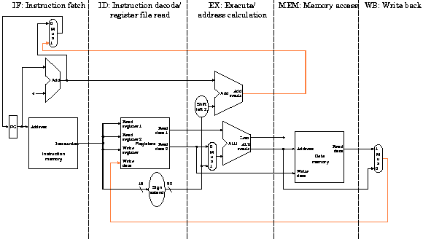
Recall: Single-cycle Datapath

Slide 9
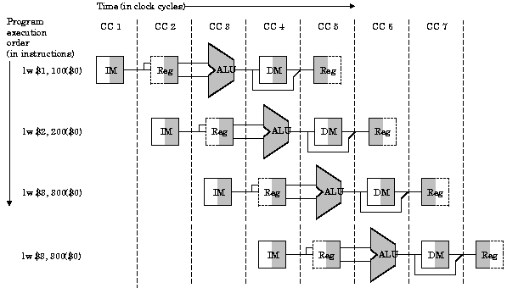
Pipeline Representation

Slide 10
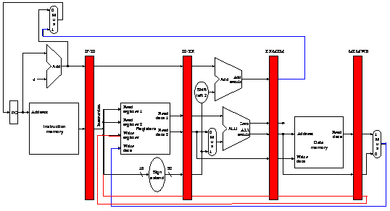
Pipelined Datapath
Control HW
IF ID EX MEM WB

Slide 11
Conclusions
Pipelining improves efficiency by:
  Regularizing instruction format => simplicity
  Partitioning each instruction into steps
  Making each step have about the same work
  Keeping the pipeline almost always full (occupied) to maximize processor throughput
Pipeline control is complicated
  Forwarding
  Hazard detection and avoidance
Next : Pipeline control design and operation

